Slide 1
Adapter Patterns
Spice Boys

Slide 2
Why use it?
They are used to make two disconnected elements compatible by using a middleman called an adapter.
Easy to understand and implement
Physical adapters are used in real world situations frequently

Slide 3
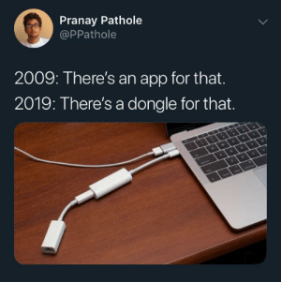

Slide 4
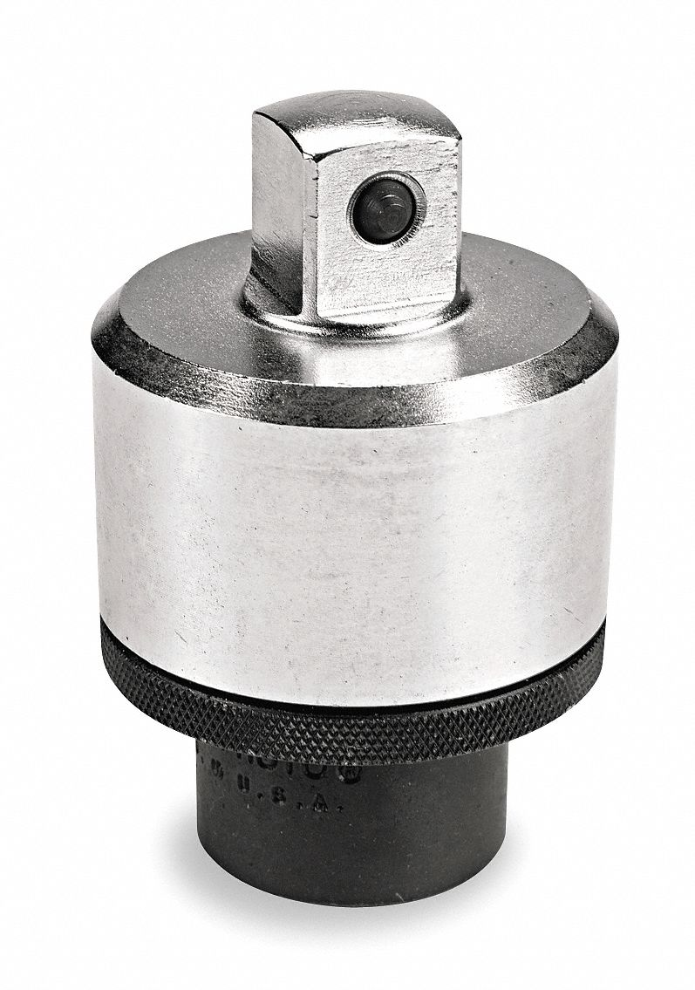
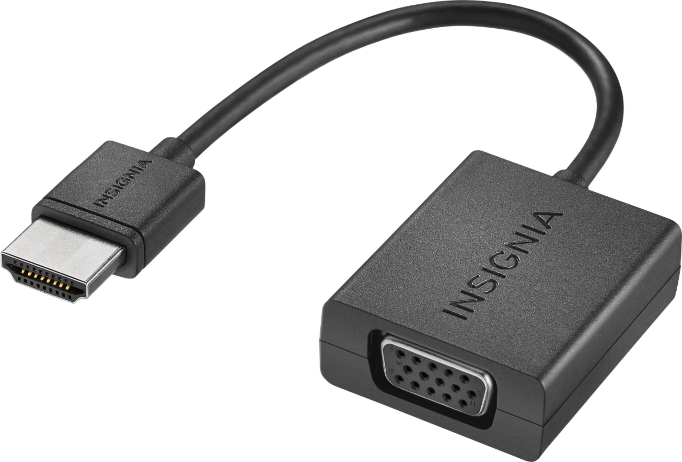
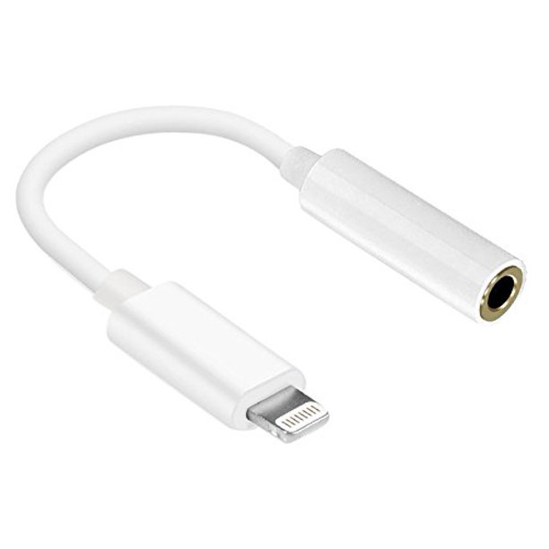
Examples of Adapters Being Used
VGA to HDMI adapter to make an older monitor compatible with a new GPU
iPhone dongle used to connect a 3.5mm headphone jack to a lightning port
Bit socket adapter for matching socket shape

Slide 5
Components of an Adapter Pattern
Adaptee - the object being adapted by an adapter to a different objects format
Adapter - the medium between two objects interfaces
Client - the object that the adaptee is being adapted to fit

Slide 6
Components of an Adapter Pattern
In the example of the VGA to HDMI adapter, the adaptee would be the HDMI output for the GPU, and the client would be the VGA input of the older monitors. The adapter would be the middle component that converts the input into the proper output. (VGA to HDMI).

Slide 7
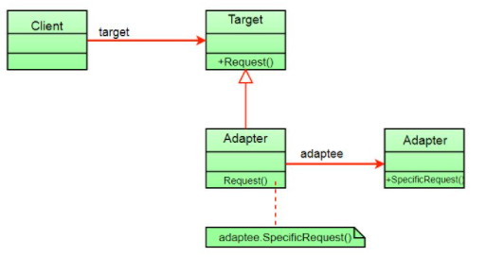
Class Diagram
Client points to a target, requesting for adapter to create the target interface
Adapter converts the adaptee object to fit the target interface, and present to the client
When the client calls a specific method, the adapter interprets the call as one of the adaptee’s methods

Slide 8
Advantages and Disadvantages
Advantages:
This pattern allows for flexibility and reusability
Reduces complexity of inputs and makes data more manageable
Adapters are often cheaper than creating brand new components to a system
Disadvantages:
All requests must be forwarded, causing latency and increased overhead
At times, more than one conversion may be necessary to connect the adaptee to a client, thus further increasing overhead

Slide 9
Overview
The adapter pattern is analogous to physical adapters that are frequently used in the real world, such as using cable adapters to allow older components of a machine to receive information about a newer, incompatible component.
Adapter patterns allow disconnected objects to be able to communicate with each other, after the software has been designed.
While adding overhead to the software, this pattern also adds manageability to data.

Slide 10
References
“Adapter Pattern.” GeeksforGeeks, 1 Sept. 2021, https://www.geeksforgeeks.org/adapter-pattern/.
“Design Patterns and Refactoring.” SourceMaking, https://sourcemaking.com/design_patterns/adapter#:~:text=The%20Adapter%20pattern%20allows%20otherwise,the%20drive%20is%20the%20same.

